Slide 1
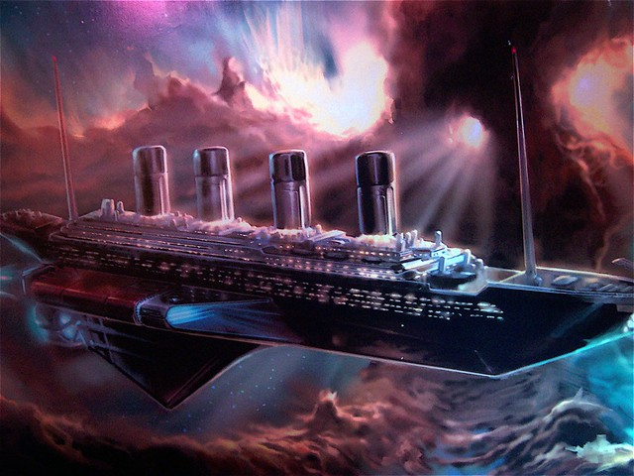
Spaceship Titanic
Shrey Shah, Robert Feliciano, and Ariela Litvin
CS 559 Final Project Group 18
Notes:
Robert

Slide 2
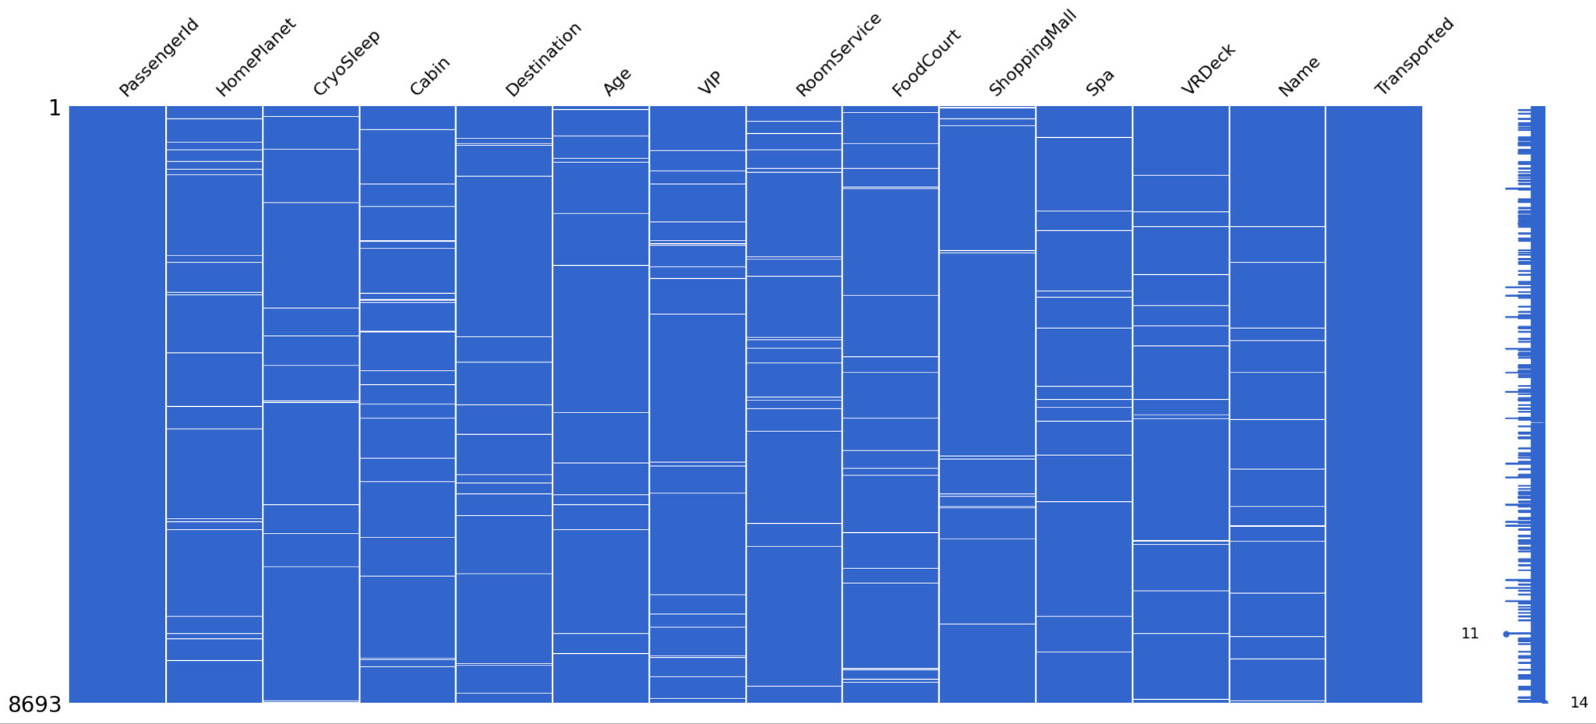
Exploratory Data Analysis

Slide 3
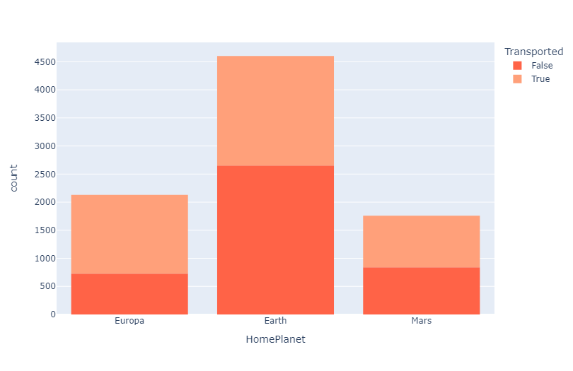
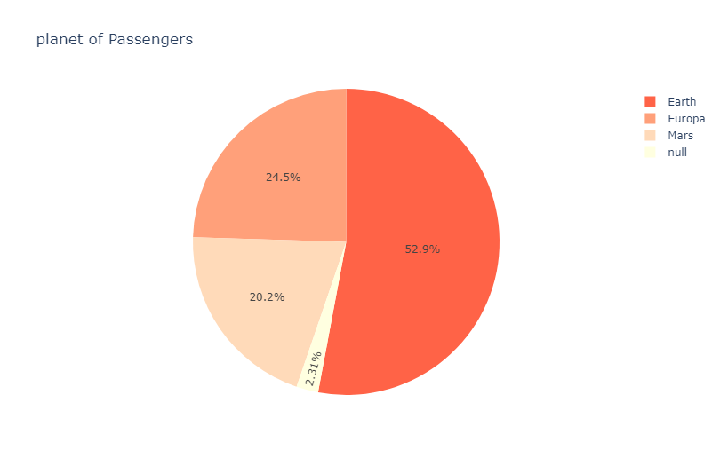
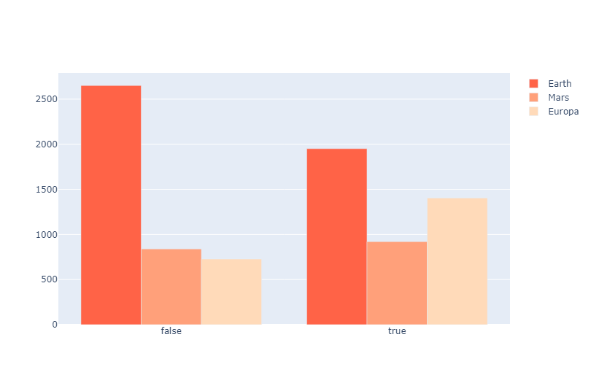
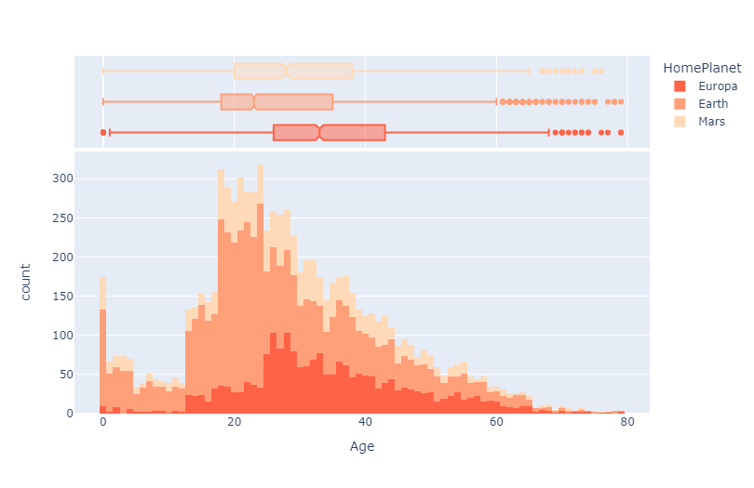
Exploratory Data Analysis

Slide 4
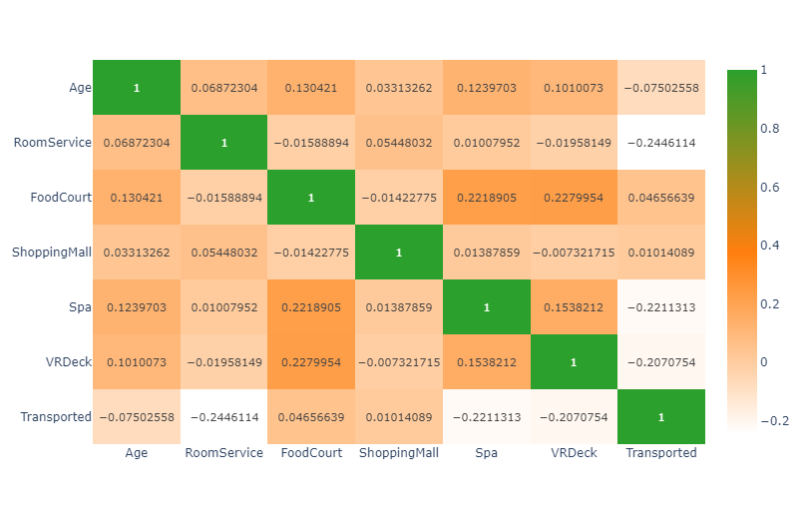
Correlation between Features

Slide 5
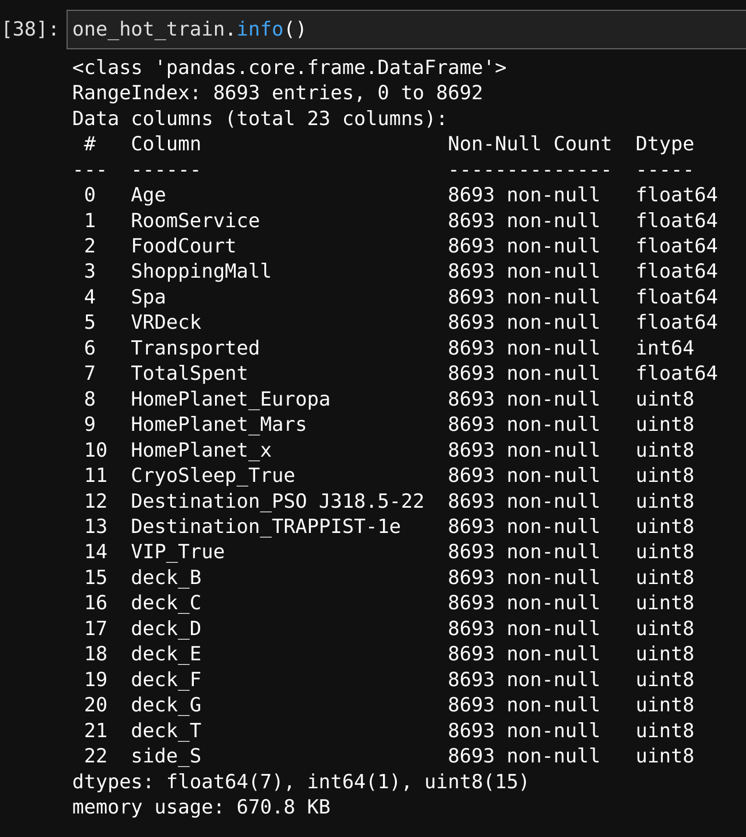
Data After Preprocessing & One Hot Encoding

Slide 6
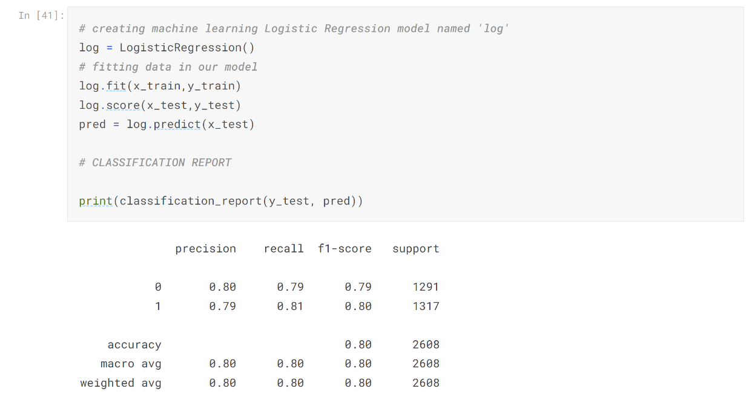
Model 1 - Logistic Regression

Slide 7
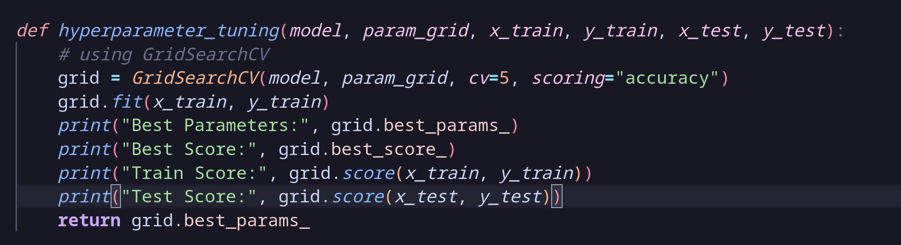
Our Hyperparameter Tuning Function
Notes:
Robert

Slide 8
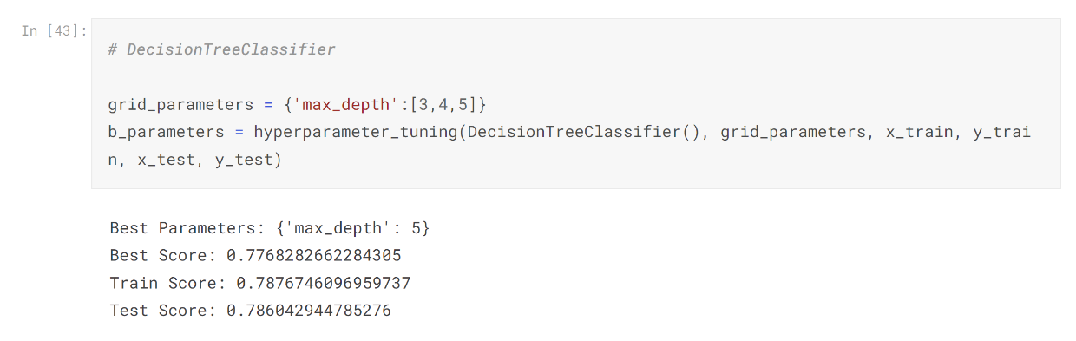
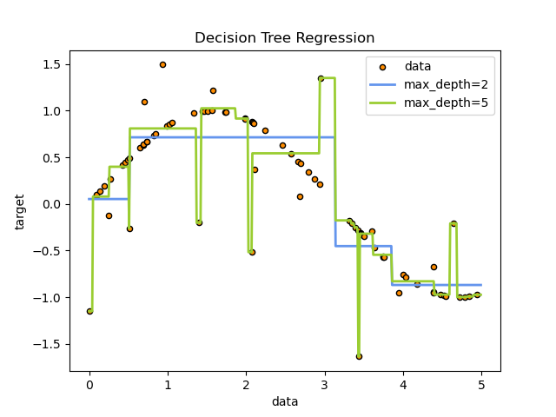
Model 2 - DecisionTreeClassifier
Courtesy of scikit-learn.org
Notes:
Robert

Slide 9
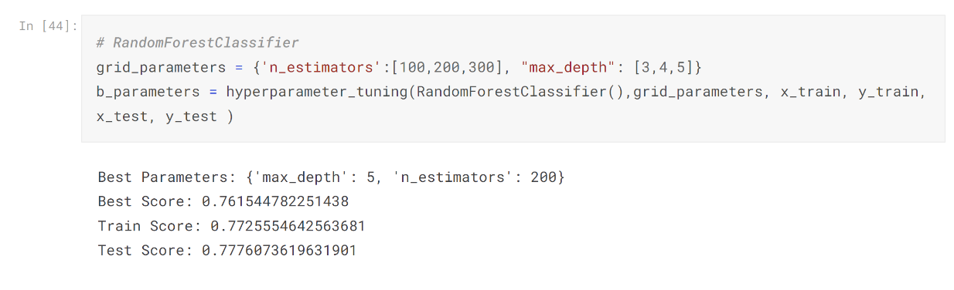

Model 3 - RandomForestClassifier
Courtesy of Analytics Vidya
Notes:
Ariela

Slide 10
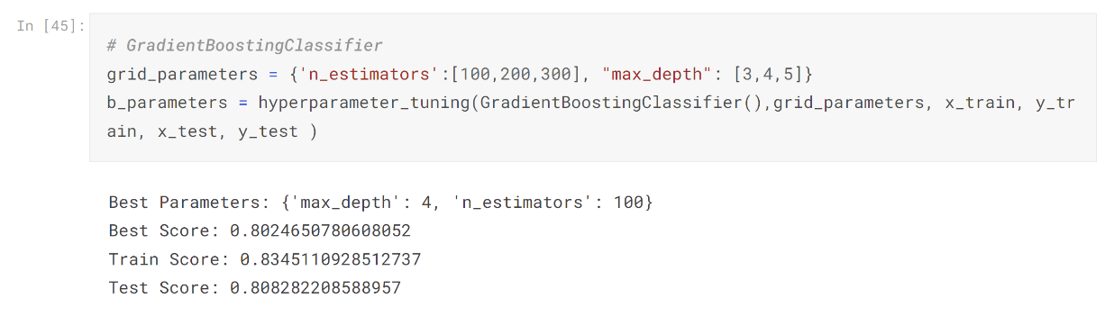
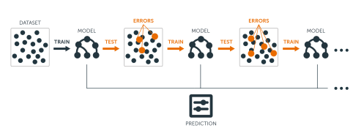
Model 4 - GradientBoostingClassifier
Courtesy of Artificial Intelligence Wiki
Notes:
Ariela

Slide 11
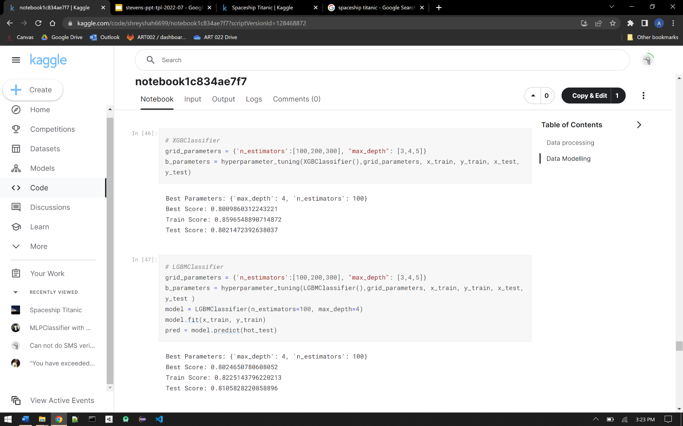
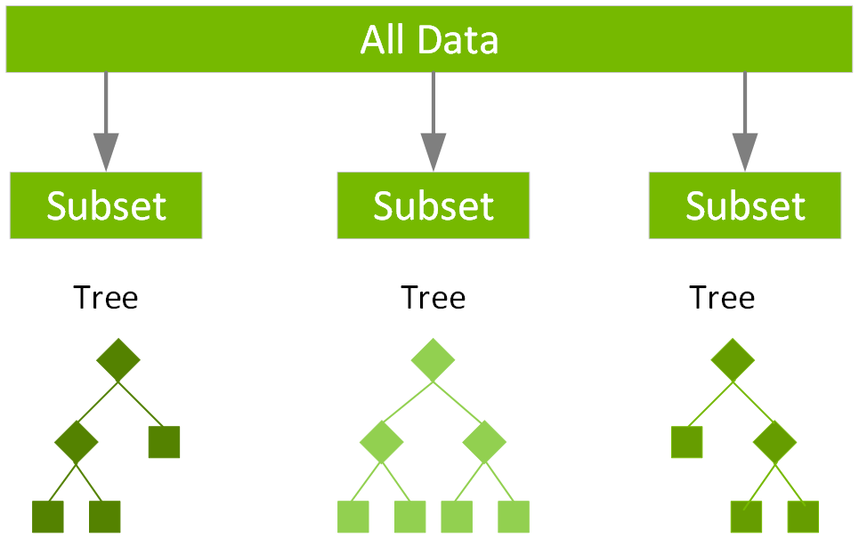
Model 5 - XGBClassifier
Courtesy of NVIDIA

Slide 12
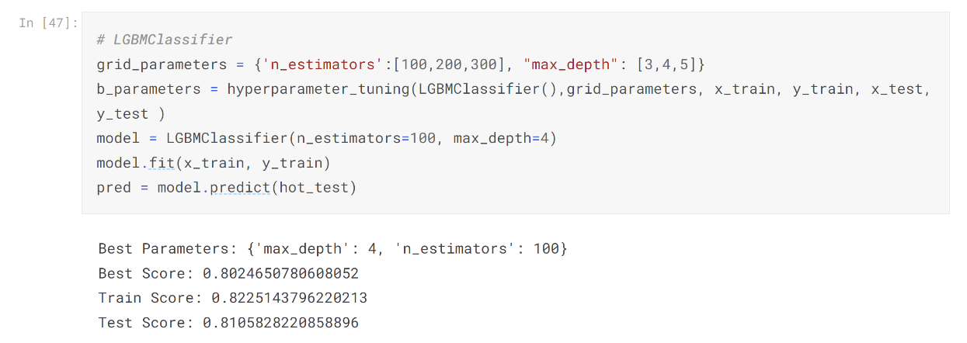
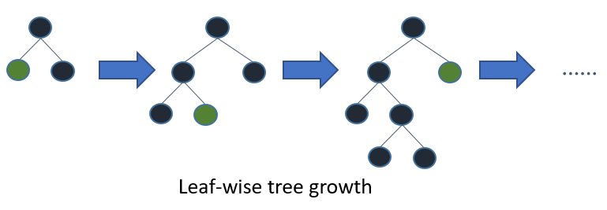
Model 6 - LGBMClassifier
Courtesy of Kaggle
Notes:
Shrey

Slide 13
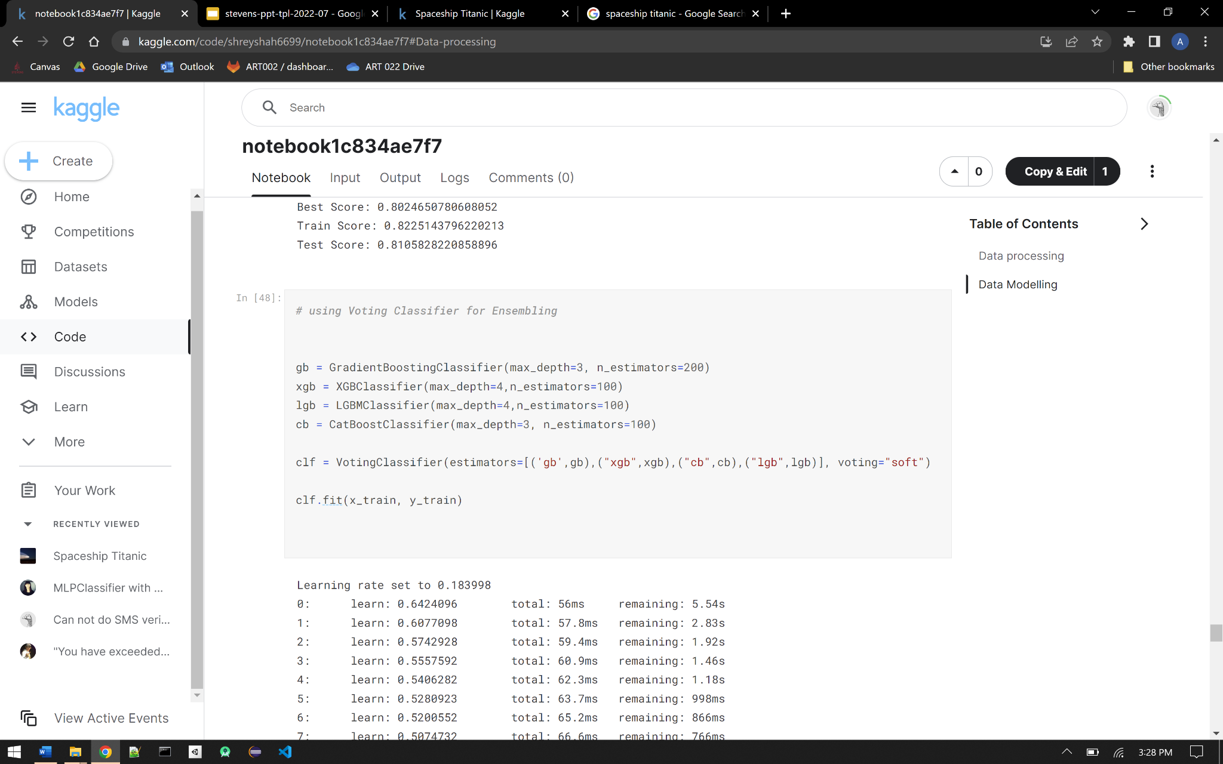
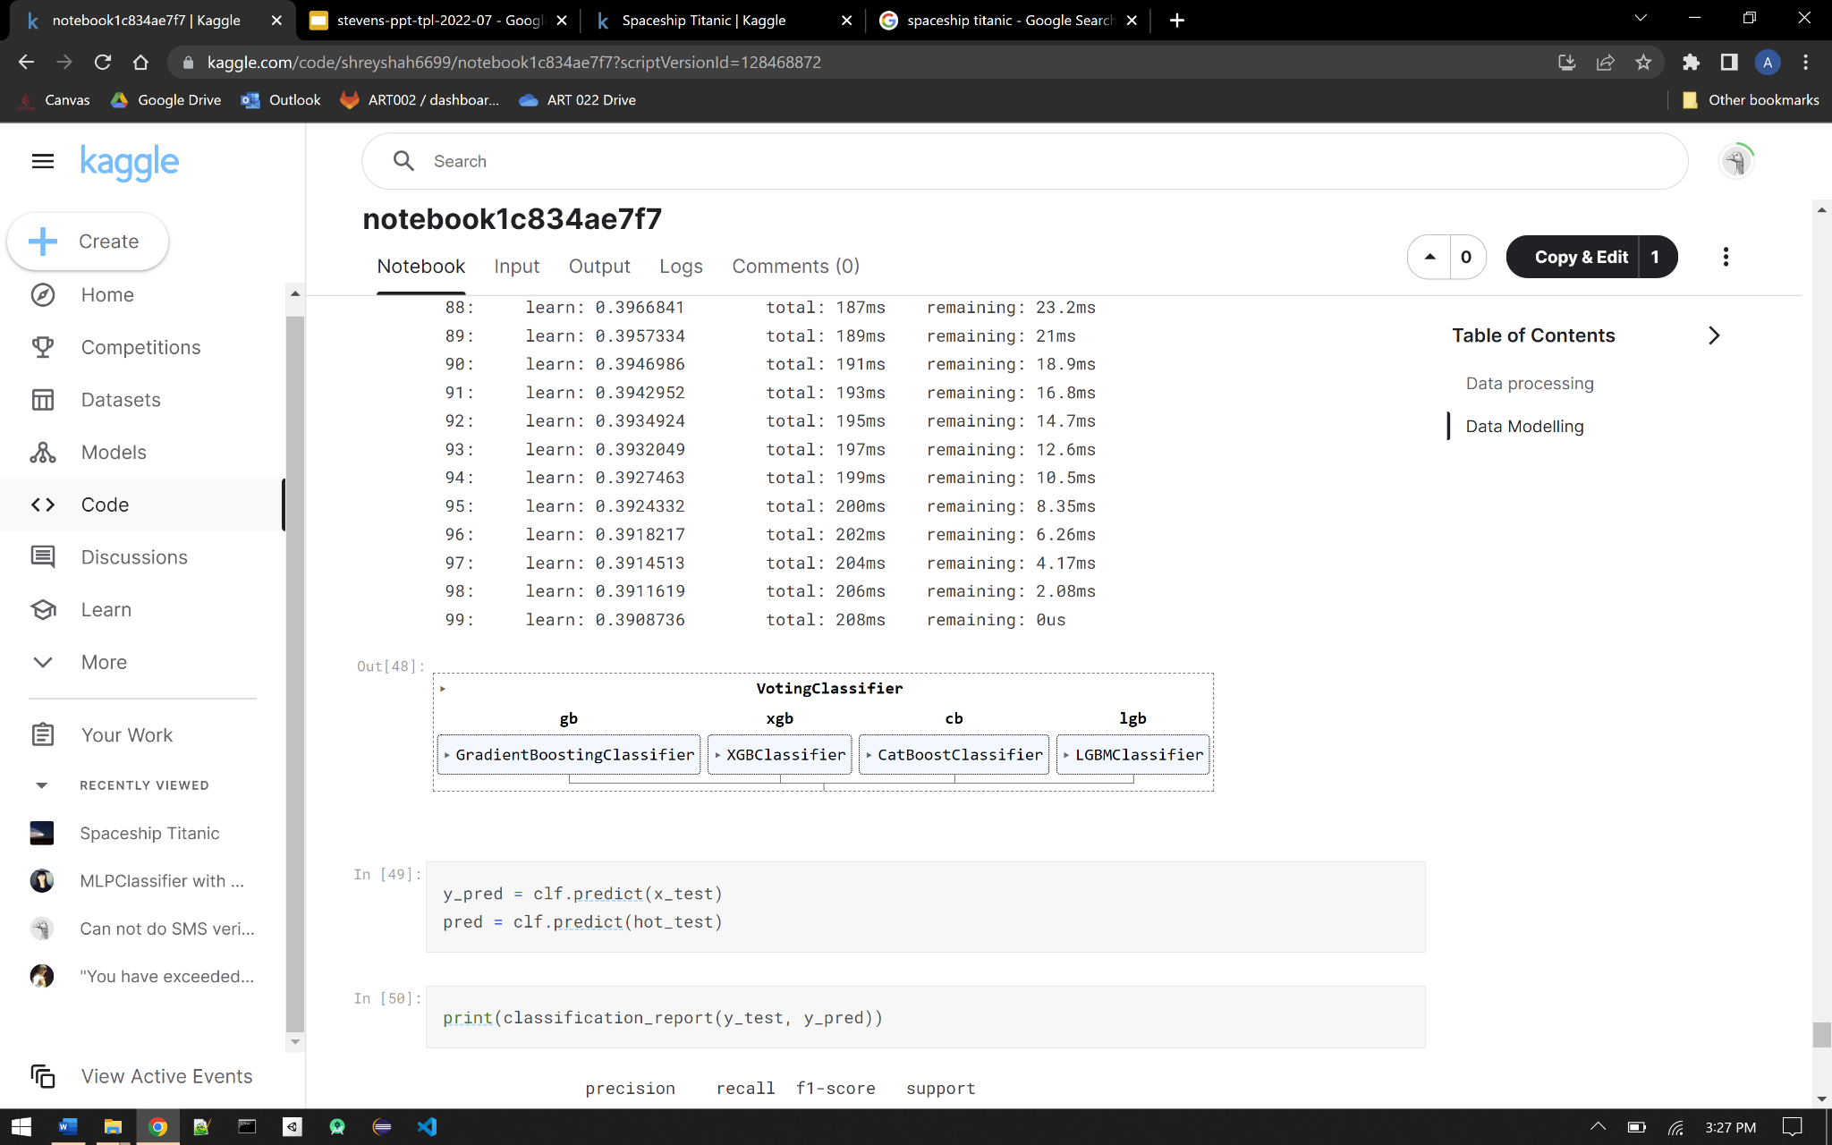
Voting Classifier for Ensembling
Notes:
Shrey

Slide 14
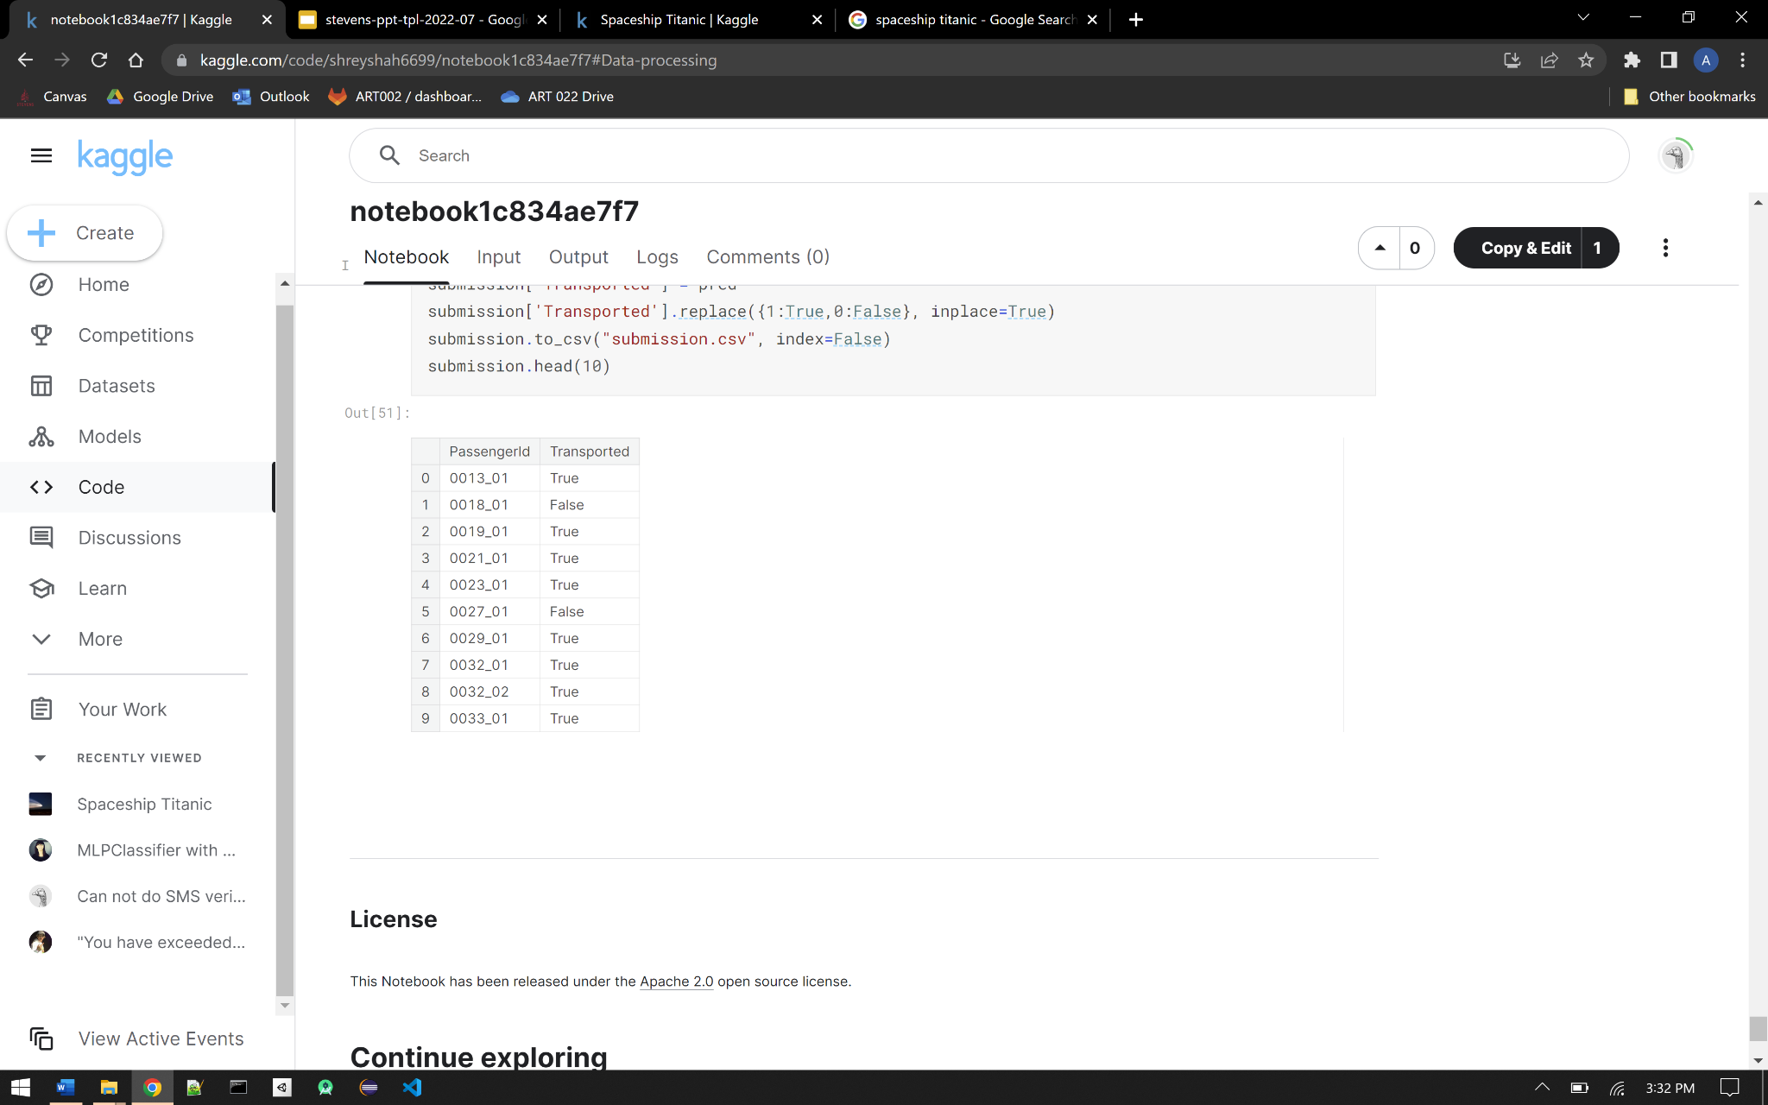
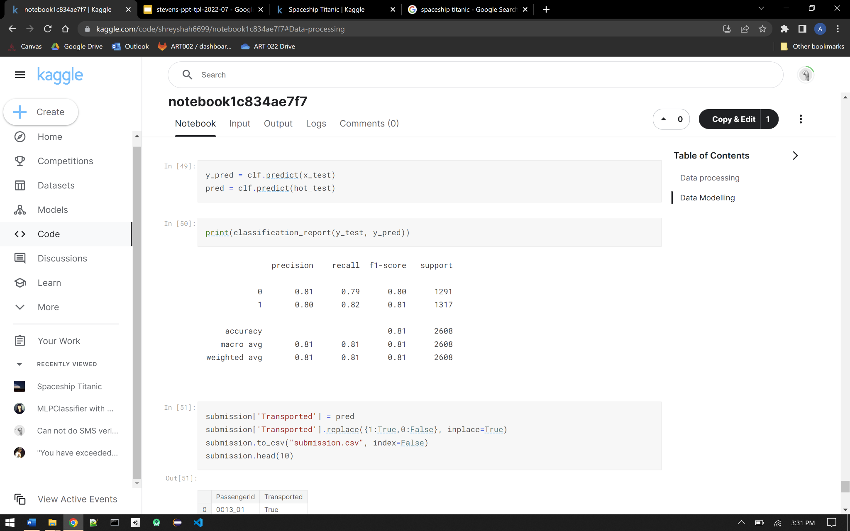
Results & Accuracy
Notes:
Shrey

